Slide 1
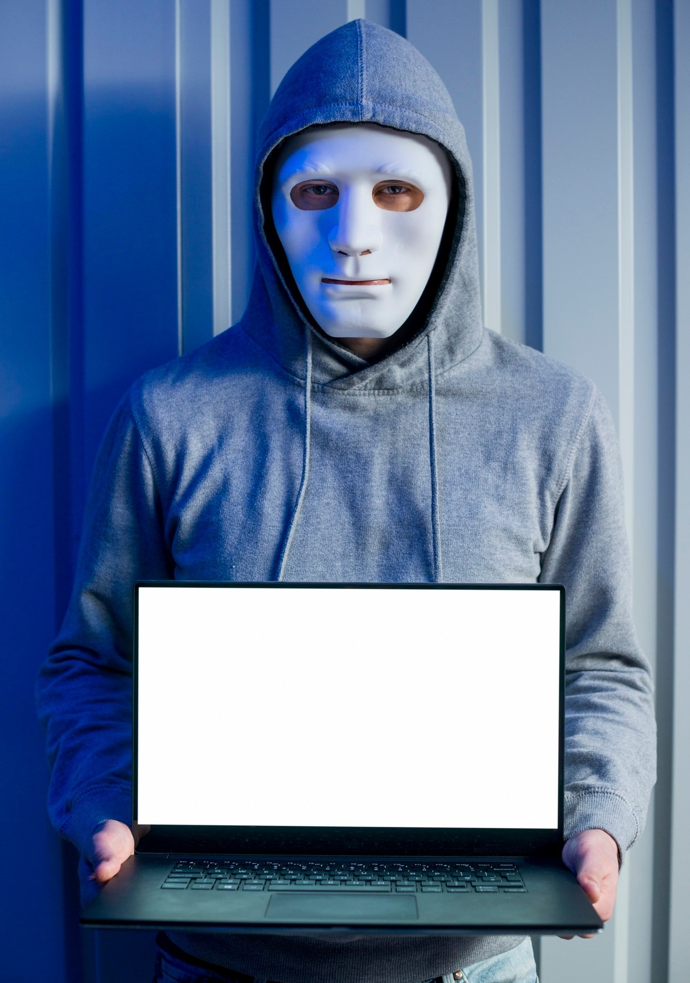
Improving Defense Against Phishing: Educating on Identiﬁcation Strategies and Preventative Measures

Slide 2






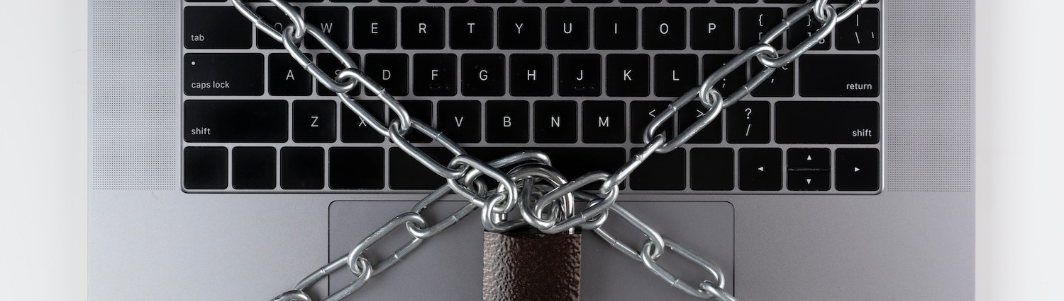
Phishing is a cybercrime that involves tricking individuals into revealing sensitive information. Understanding the tactics used by attackers is essential for recognition and prevention. This presentation aims to provide insights into identifying phishing attempts and implementing effective strategies to safeguard against them.

Slide 3


Phishing is a method used by cybercriminals to deceive individuals into revealing conﬁdential details, such as passwords and credit card information. This malicious practice often involves emails or messages that appear legitimate, tricking recipients into clicking on harmful links or providing sensitive data.
Awareness and caution are essential to combat phishing attempts.

Slide 4


Phishing is a major digital threat, appearing as email phishing, spear phishing, and whaling. Email phishing uses generic messages, spear phishing targets speciﬁc individuals, and whaling focuses on executives. Awareness and education are vital for prevention, along with strong security measures to reduce scam risks.

Slide 5


Phishing emails often contain suspicious links, poor grammar, or urgent requests for sensitive information. They may also use alarming language to provoke immediate action. Look for signs such as mismatched sender addresses, unexpected attachments, and generic greetings. Training to identify these red ﬂags is essential for protection against cyber threats. Regularly updating security measures and educating employees can signiﬁcantly reduce the risk of falling victim to these scams.

Slide 6


Cybercriminals employ various techniques, such as spooﬁng legitimate websites or using malicious attachments. They may also create fake login pages to steal credentials. Awareness of these methods can signiﬁcantly reduce the risk of falling victim.

Slide 7

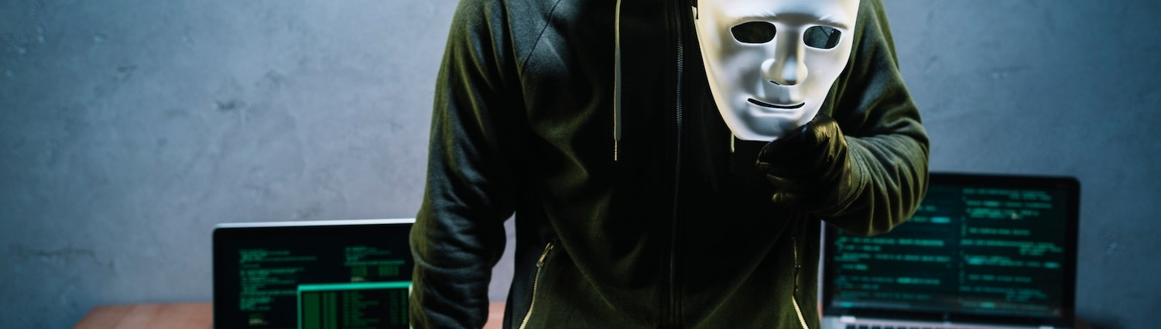
The consequences of phishing can be severe, including ﬁnancial loss, identity theft, and damage to an organization's reputation. Understanding the potential impact emphasizes the importance of being vigilant and prepared against such threats.

Slide 8



Implementing multi-factor authentication, regularly updating passwords, and using security software can help prevent phishing attacks. Training employees to recognize phishing attempts is also crucial for maintaining a secure environment.

Slide 9





Regular training sessions on phishing recognition and response protocols are vital. Employees should be encouraged to report suspicious activities immediately. A well- informed workforce is the ﬁrst line of defense against phishing attempts.

Slide 10


Encourage individuals to report phishing attempts to their IT department or relevant authorities. Reporting helps track and mitigate threats, contributing to a safer organizational environment. Awareness and action are key elements in combating phishing.

Slide 11




Examining real-life case studies of phishing attacks can provide valuable insights. Understanding how these attacks occurred and the responses taken can inform better prevention strategies. Learning from past incidents is essential.

Slide 12





As technology evolves, so do phishing tactics. Emerging trends include AI- driven phishing and more sophisticated social engineering techniques. Staying informed about these trends is crucial for ongoing protection against phishing threats.

Slide 13




Safeguarding against phishing requires a combination of education, awareness, and technology. By recognizing the signs of phishing and implementing effective prevention strategies, individuals and organizations can signiﬁcantly reduce their vulnerability to these attacks.

Slide 14
Thank you for your attention. Your engagement is important!

